Slide 1
IASA 01/17/20 - Firewalls
Don’t forget to sign in 😃
Thanks Chris M for the prebuilt prezzi !! 😃

Slide 2
Agenda 🗓
Sign in, get pizzas
Go over how firewall rules work
See some firewall setup in Linux (Implement key rules!)
See firewall setup in Windows (Implement key rules!)

Slide 3
Firewall Concepts 🔥
Firewalls control network traffic in and out of a device
Can be local software based or physical network devices
Does some routing
Rules go in chronological order (1st rule is very important)
Interface with the core (kernel) of the OS

Slide 4


Slide 5
What is the Kernel of an OS? 🍿
So "the kernel" of an operating system is the minimum needed to run the various hardware, the minimum needed to get programs into and out of memory, and the minimum needed to let programs ask the kernel to operate the hardware for them (instead of needing the programs to operate the hardware themselves).
https://www.reddit.com/r/explainlikeimfive/comments/5u2nkx/eli5_what_is_a_linux_kernel/

Slide 6
The different firewalls...🔥
Firewalld ‘firewall daemon’ - (Debian, CentOS, Fedora)
Firewall daemon found on most Linux distros
UFW ‘uncomplicated firewall’ - (Ubuntu)
GUI/CLI firewall, mostly found on ubuntu
IPtables (additional software)
Reliable and robust firewall, provides a well documented and admin based experience

Slide 7
IPTables 🔥
IPtables is based off of netfilter. Netfilter is a kernel based platform for firewalls to perform packet filtering, NAP/NAPT, and other packet handling.
Advantages
Extremely versatile
Closest kernel-level control you can get
Extensive documentation and examples
Can become Linux Kernel Firewall Jedi if you master IPTables 🙏
Disadvantages
Complex
No GUI
Not forgiving

Slide 8
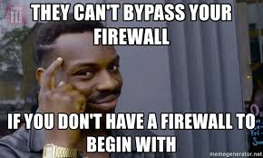

Slide 9
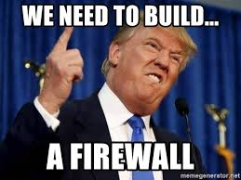

Slide 10
Firewall Concepts (cont) 🔥
Example of a rule:
ALLOW ANY ANY
DROP ANY ANY
Why is this a bad rule?

Slide 11
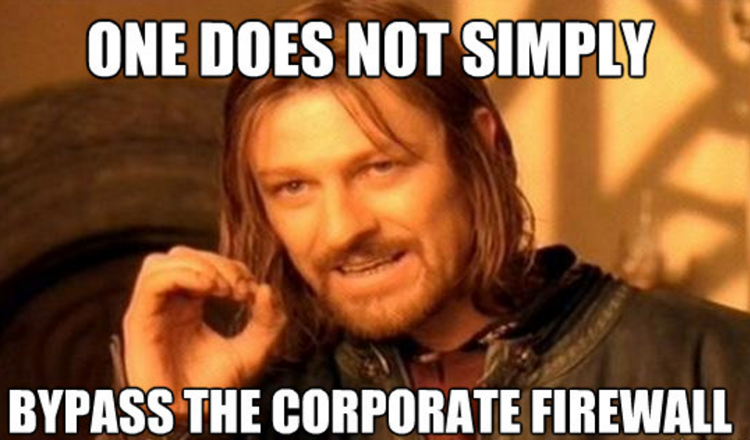

Slide 12
Using IPTables 🔥
NOTE: Because you are working directly with the Linux Kernel, all commands need to be run as sudo
You can check if iptables is installed by typing
which iptables
You should get something like /sbin/iptables or /usr/sbin/iptables
This means the actual application is in the /sbin/ directory
Also NOTE:
Iptables rules are ephemeral, which means they need to be manually saved for them to persist after a reboot.
Install CLEAN persistent IPTables:
sudo apt-get remove iptables iptables-persistent
sudo apt-get install iptables iptables-persistent

Slide 13
Using IPTables 🔥
With RedHat based systems, you will need to install via these commands.
Install IPtables via DNF or YUM.
yum install iptables-services
Dnf install iptables-services
Also NOTE:
Iptables rules are ephemeral, which means they need to be manually saved for them to persist after a reboot.
In RedHat based OS you have to save via this command.
service iptables save

Slide 14
Using IPTables 🔥
How to check current rules?
sudo iptables --list
Remember, to use sudo if you see something like this:

Slide 15
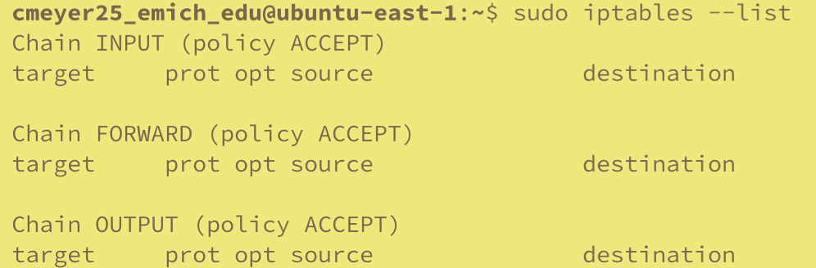
Using IPTables 🔥
IPTables Components
INPUT = Inbound Connections
Ex. I ssh to your box
FORWARD = For packets Not destined for your device, but are passing through it. Think like a middleman rule, like a mini router.
OUTPUT = Outbound
I wanna go to facebook and watch cat videos

Slide 16
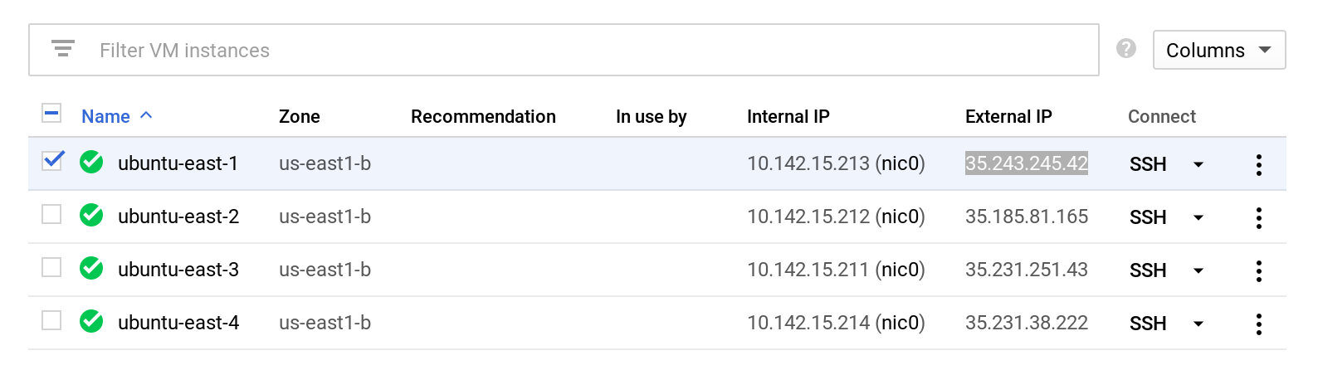
Blocking Incoming IP Addresses
Have the person next to you run check the External IP of their VM, and have them ping your external IP. It should work.
ping 35.243.245.42

Slide 17
Blocking Incoming IP Addresses
To DROP an incoming IP address:
iptables -A INPUT -s IP.Address.Here. -j DROP
Example, blocking Inbound Google DNS
iptables -A INPUT -s 8.8.8.8 -j DROP

Slide 18
Breaking down the command
iptables -A INPUT -s 8.8.8.8 -j DROP
iptables
The program you are using
-A
Append argument. This will add the rule to the bottom of your rule list
INPUT
Setting this to the INBOUND chain
-s
Add IP address to the chain. This is the “what” we’re working with

Slide 19
Breaking down the command
iptables -A INPUT -s 8.8.8.8 -j DROP
8.8.8.8
IP address or range of IP addresses you want to interact with
-j DROP
Specifies what to do with the IP address. Here, we are saying to DROP, or discard the packet.
This means that ANY incoming connections from Google’s DNS will be DROPPED

Slide 20
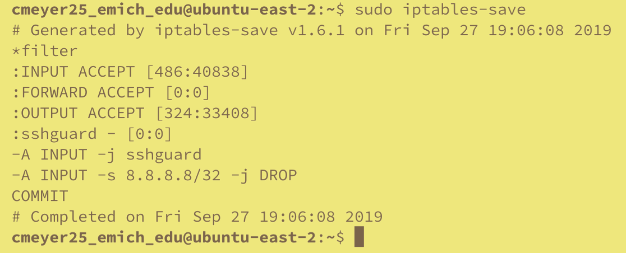
Verify The Rules Were Applied
iptables --list
This will list all current rules
If you see the rule, you now need to SAVE the rule
sudo iptables-save
/etc/sysconfig/iptables
Now have your friend ping your IP address again
If you did this properly, they should not be able to ping it anymore

Slide 21
Why this is so important
This is one of the most rock-solid ways to secure a device
If you cannot communicate with a device, you can’t really exploit it…
Consistent
Installed on MOST Linux distros across the board
Commands are extremely similar if not the same no matter which OS
Can be scripted!
Very good skill to know

Slide 22

Windows Firewall
Why use Windows Firewall?
It’s Free
It’s pre installed and useful in environments you don’t have network access
It’s better than nothing
Notes:
In Competition environments you don’t have the ability to download third party solutions (GlasssWire, Comodo, Etc)

Slide 23
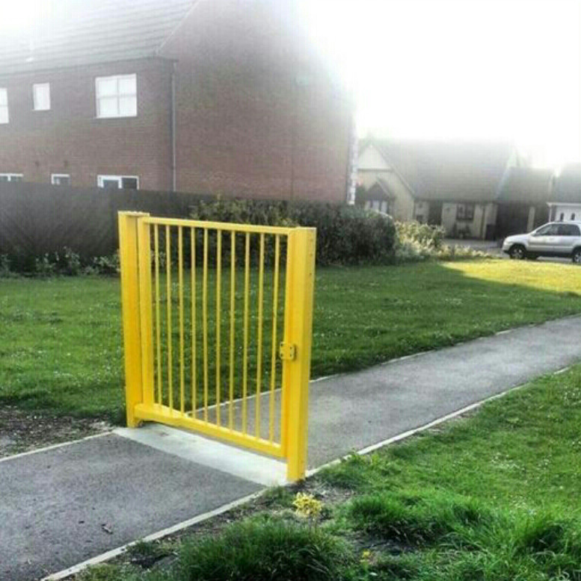
In-Production Deployment

Slide 24
Types of Windows Firewall
Domain Networks - This setting is applied when the computer is connected to a domain controller, which is controlling a Windows domain.
Private Networks - This setting is applied when a connection to a network for which the computer's account is not associated with. This can be a different domain or home network. A computer can only be joined to one domain at a time, so if the computer is not joined to the Domain network, it can only be joined to a Private or Public network. It is suggested that the Private network profile of settings be more restrictive than the Domain network profile of settings.
Public Networks - This setting is applied when a connection to a domain is made through a public network, such as at an airport, hotel, or coffee shop. Since the security of these networks is unknown and not really controlled by the user running the computer, it is suggested that the Public network profile of settings be more restrictive than either the Domain network or Private network.

Slide 25
Why Deploy With Group Policy
Base Security Template can be deployed quickly
Time is valuable in competition environments
Malicious IPs can be blocked on any joined machine quickly.
Reduces time, eliminates the need to login to every box

Slide 26
Where do I deploy this?
In Windows Server 2003, 2008, 2012, 2016, 2019 You can find the GPO object Here:
Computer Configuration > Windows Settings > Security Settings > Windows Firewall with Advanced Security

